Slide 1
Interfaces - Packages – Abstract classes

Slide 2
Interface
An interface can have methods and variables
An interface is an abstract "class" that is used to group related methods with "empty" bodies
The interface must be "implemented" by another class with the implements keyword
The body of the interface method is provided by the "implement" class

Slide 3
Syntax
interface <interface_name>
{
// declare constant fields
// declare methods that abstract by default
}
Example :
interface Animal {
public void animalSound();
}

Slide 4
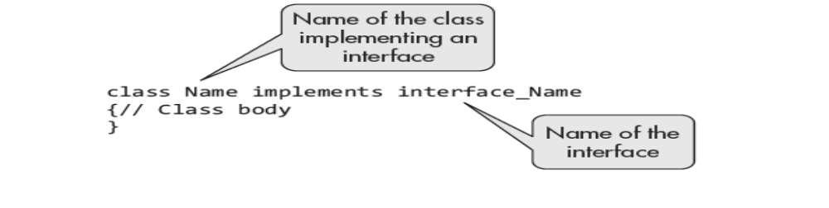
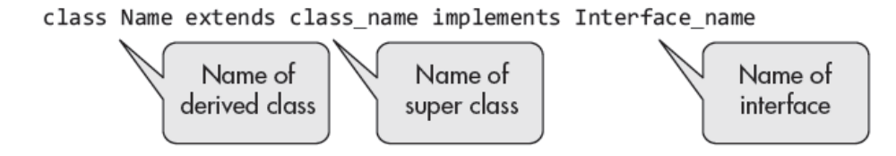
Implementation of Interface
Declaration of class that implements an interface
If a class extends another class as well as implements interfaces, it is declared as

Slide 5
Example program
import java.io.*;
interface in1
{
final int a = 10; // public, static and final
void display(); // public and abstract
}
class interfacetestClass implements in1
{ public void display()
{ System.out.println("First prg on interface"); }
public static void main (String[] args)
{
interfacetestClass t = new interfacetestClass();
t.display();
System.out.println("Value of A is :" +a);
// System.out.println("Value of A is :" +t.a);
}
}

Slide 6
Rules
It cannot be used to create objects
Interface methods does not have a body - the body is provided by the "implement" class
On implementation of an interface, you must override all of its methods
Interface methods are by default abstract and public
Interface attributes are by default public, static and final
An interface cannot contain a constructor (as it cannot be used to create objects)

Slide 7
Multiple class implementing the interface
Prg : interfacetestClass2
  The @Override annotation should be used on the definitions of interface methods in the class.

Slide 8
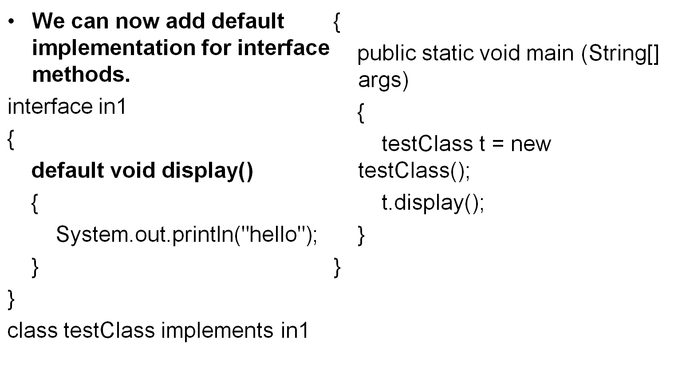
New features added in interfaces in JDK 8

Slide 9
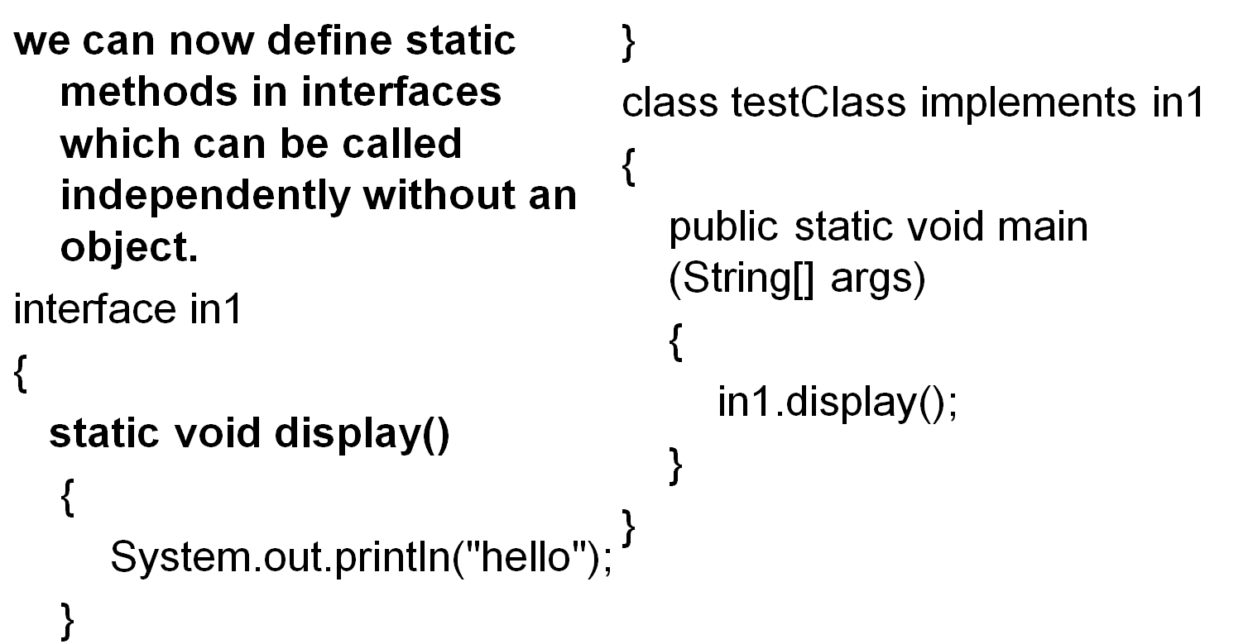
New features added in interfaces in JDK 8

Slide 10
Problem to solve
Using interface concept compute the area of a square and circle by using the computearea()

Slide 11
Nested interface
We can declare interfaces as member of a class or another interface - member interface or nested interface.
Interfaces (or classes) can have only public and default access specifiers when declared outside any other class
Nested interface declared in a class can either be default, public, protected not private. While implementing c_name.i_name where c_name is the name of the class and i_name is the name of the interface itself.

Slide 12
Example Program
Prg - NestedInterface

Slide 13
Similarities between Interface and Class
Declaring an interface is similar to that of class; the keyword class is replaced by keyword interface.
Its accessibility can be controlled just like a class.
An interface declared public is accessible to any class in any package, whereas the ones without an access specifier is accessible to classes in the same package only.
One can create variables as object references of interface that can use the interface.
It can contain inner classes (nested classes) and inner interfaces.
Since Java 8, an interface can have full definitions of methods with default or static modifiers.

Slide 14
Package
A package in Java is used to group related classes. Think of it as a folder in a file directory. We use packages to avoid name conflicts, and to write a better maintainable code.
Packages are divided into two categories:
  Built-in Packages (packages from the Java API)
  User-defined Packages (create your own packages)

Slide 15
Built-in Packages
These packages consist of a large number of classes which are a part of Java API. Some of the commonly used built-in packages are:
  java.lang: Contains language support classes(e.g classed which defines primitive data types, math operations).
  java.io: Contains classed for supporting input / output operations.
  java.util: Contains utility classes which implement data structures like Linked List, Dictionary and support for Date / Time operations.
  java.applet: Contains classes for creating Applets.
  java.awt: Contain classes for implementing the components for graphical user interfaces (like button , ;menus etc).
  java.net: Contain classes for supporting networking operations.

Slide 16
Build in Package Eg: import java.util.*; - util is a subpackage created inside java package.
User defiend
  These are the packages that are defined by the user.
  First we create a directory myPackage (name should be same as the name of the package).
  Then create the MyClass inside the directory with the first statement being the package names

Slide 17
package myPackage;
public class MyClass {
public void getNames(String s)
{ System.out.println(s); }
}
/* import 'MyClass' class from 'names' myPackage */
import myPackage.MyClass;
public class PrintName {
public static void main(String args[]) {
String name = “Java";
MyClass obj = new MyClass();
obj.getNames(name);
} }
Note : MyClass.java must be saved inside the myPackage directory since it is a part of the package.

Slide 18

Abstract class

